Slide 1
Welcome to Back to School Night 2023-2024
Please find your child’s seat. Log in to their computer. Their username and password are provided next to their computer. Please login and follow the directions on the paper provided! Please raise your hand if you need assistance.
SECOND GRADE
TRACK D
Notes:
1

Slide 2
About Me
Mrs. Atherton
Professional Experience:
Bachelor of Arts, Cal Poly Pomona
University Master of Science, California State University Fullerton
2nd Grade
4th Grade
Notes:
2

Slide 3
Volunteer Opportunities
Room Parent/s
Meet the Masters (4)
cut
copy
laminate
organize packets
separate math lesson papers…
Most of these can be completed at home. I will send home with you child or you are welcome to pick it up and drop off outside our classroom.
Please contact me on parent Square if you are interested in any of these opportunities.
Join the PTO!

Slide 5
Homework*
Homework will be posted on
Parent Square and Google Classroom.
District guidelines are 20-30 of focused minutes daily as well as an additional 20 minutes a day of outside reading.
Homework will be assigned Monday through Thursday.
1. Read: 20 minutes.
2. Reading Log. Due every Friday.
3. Math: Math workbook will be kept at home. Complete
the homework page that matches the lesson.
The day before a test a Practice Test will be sent home.
On the day of the Topic test there will be no homework.
Practice math facts 10 minutes daily.
4. Unfinished classwork.
5 Test prep when necessary.
Notes:
5

Slide 7
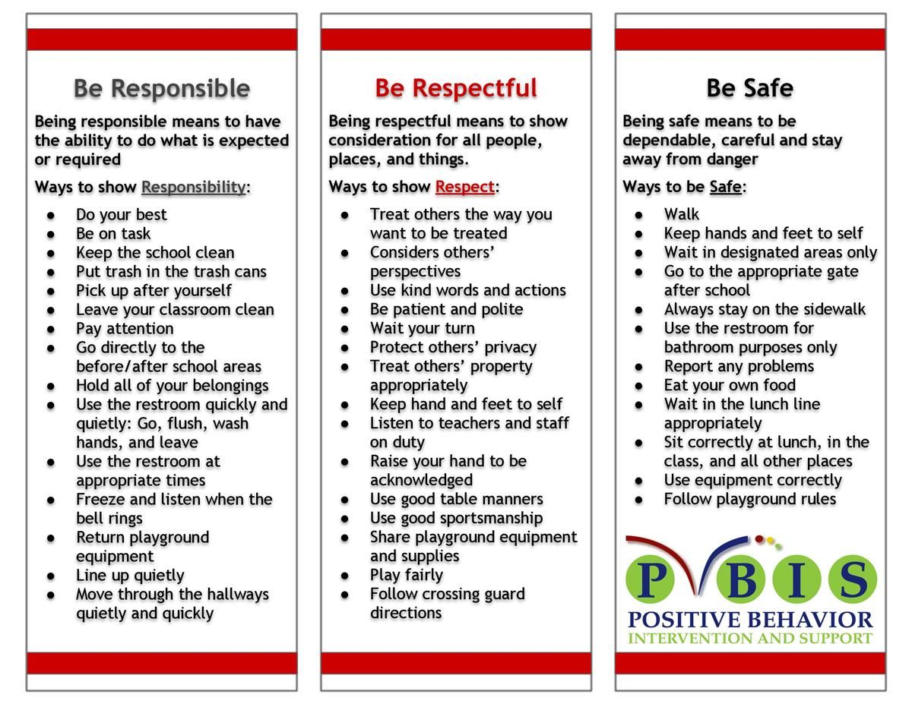
School Wide Behavior Expectations
Rick Morris Behavior Demonstrates exemplary behavior hone call home, email, or notification on daily behavior calendar.

Slide 8
Incident Logs
Incident Logs are used for OUTSIDE minor playground offenses.
Examples: running before, during, or after school, pushing, playing after bell, using bathroom after the bell …
Parent signature REQUIRED
Grades 1-6
Incident Logs will warrant the following consequences (per trimester):
1st: Warning
2nd: Loss of a recess and citizenship grade on the report card lowered one level
3rd: Office referral for 1 lunch detention
4th: Parent/Student/Teacher Conference with an Administrator

Slide 9
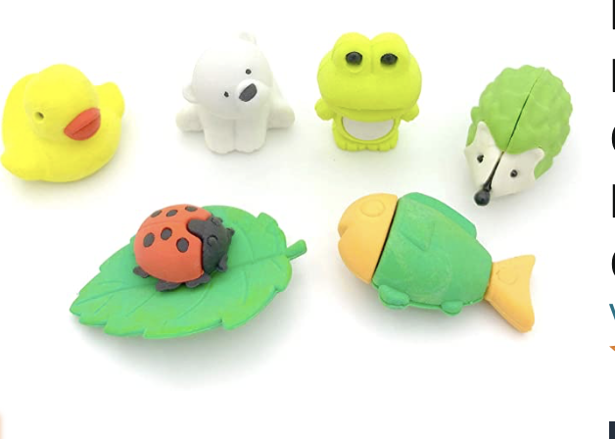
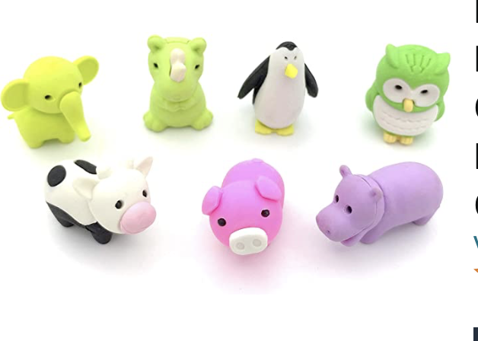
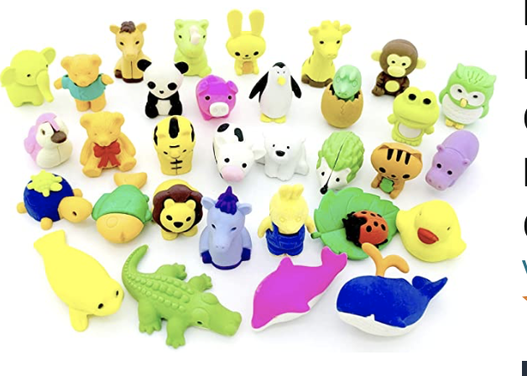
Behavior Expectation Rewards
Student’s will earn AIM High points for positive behavior both in the classroom and on the playground.
Students will be able to redeem points to purchase DESK PETS!

Slide 10
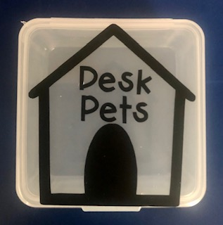
How does my student earn a Desk Pet?
Follow directions quickly.
Be kind with words and actions.
Be ready to learn and have all necessary materials.
Stay focused in line. Walk with a purpose.
Stay on task and complete class work.
When students do these things, they can earn up to 25 points a week! “Jack’s Pet Shop”
will be open approximately once a month.
Students can buy; pets, accessories, food for their pets, & supplies to build their pet’s habitat.

Slide 12
Classwork
It is important that each student completes his/her classwork.
If classwork is not finished in the time allotted, the student will have to complete it at during recess or at home.
Please check your child’s “ Take Home” folder daily.
Notes:
12

Slide 13
Grading Policy
All grades are a combination of class work, tests, quizzes, class participation, homework, and/or teacher observation.
Notes:
13

Slide 14
Grading Scale
Grade/Number | Meaning
4- Excelling | Student is at the Excelling level of performance. They have an in-depth understanding of grade level performance standards expected at this point in the school year.
3- Achieving | Student is at the Achieving level of performance. They are consistently meeting the grade level performance standards expected at this point in the year.
2- Progressing | Student is at the Progressing level of performance. They are partially meeting the grade level performance standards expected at this point in the year.
1- Beginning | Student is at the Beginning/Standard Not Met level and is not yet meeting grade level performance standards expected at this point in the year.
Standards Based Grading Report Card, resulting in students receiving the grades of 1, 2, 3, and 4.

Slide 15
Best way to contact me!
EMail-mari_atherton@chino.k12.ca.us
Cell- 562-695-3850

Slide 16
Parent-Teacher Conferences are coming up.
9/11 - 9/13
Please sign up for a date/time on Parent Square, when you receive the notification.
Notes:
16

Slide 17
Absences
Please make sure your child is in school unless ill.
ATTENDANCE COUNTS!
Please try to schedule appointments after school. If you are taking your child out of school, please let me know ASAP. Work missed will need to be completed.
Missed tests will be given the next day the student returns or when time permits.
TARDIES do count against perfect attendance!
Notes:
17

Slide 18
Student Recognition
There will be 3 awards assemblies this year.
Top Flight
Captain
Lieutenant
Perfect attendance
(no absences, and no more than 2 tardies or leaving school early)

Slide 19
We’re College Bound!
University of Hawaii
Wear College Bound shirt every Monday, when available.
Aviator shirt on Fridays!
Notes:
19

Slide 22
School Supplies
Please leave extra
supplies at home.
Please keep extra school supplies at home and replenish supplies as needed throughout the year.
Pencils, Paper, Crayons, Glue Sticks, etc.
Notes:
22

Slide 23
Classroom Donations
White copy paper
(8 ½ x 11)
Unscented baby wipes
Expo Markers
Pencils
Glue sticks
Treats
Amazon Wish List
https://www.amazon.com/hz/wishlist/ls/2SQRCBYMN8HAH?ref_=wl_share

Slide 24
McGraw-Hill Reading Wonders
ELA Curriculum
Focus will be on:
Vocabulary Instruction
Reading Comprehension Skill Development
Phonics
Spelling
Grammar
Writing
Writing Domains:
Informational
Narrative
Opinion
Online Access:
Online access for students and parents can be found on your child’s ClassLink account.

Slide 25
Math Curriculum Savvas Envision Math
Focus will be on:
Operation and Algebraic Thinking
Numbers and Operations in Base Ten
Measurement and Data
Geometry
Supplemental programs utilized daily on Chromebooks in class.
Prodigy
Xtra Math
eSpark!
Online Access:
Online access for students and parents can be found on your child’s ClassLink account.

Slide 26
Other Core Subjects English Language Development (ELD)​ - Remediation, Intervention & Enrichment​ - Social Studies- Houghton Mifflin-NGSS​ - Science- NGSS​ TWIG Click 99999999 - P.E. – Appropriate shoes​ - Music- Once a week.​ -Library-Twice a month.

Slide 27
Goals for the Year
Have every student reach or exceed Common Core State and District standards.
Provide a safe, fun-filled, nurturing learning environment where children thrive.
Increase each child’s academic success in all subject areas.
Develop students’ organizational skills and sense of responsibility.

Slide 28
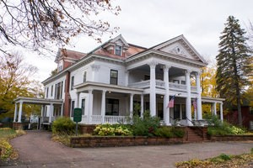
Field Trips 2023-24
Heritage Museum of Orange County
Track D
October

Slide 29
Classroom Wishlist
Amazon Classroom Wish List
https://www.amazon.com/hz/wishlist/ls/2SQRCBYMN8HAH?ref_=wl_share
@Mari-Atherton

Slide 30
Contact Information
Please feel free to send me a note or an email regarding any questions or concerns.
Cal Aero Preserve
(909) 606-8531 Ext. 8810
Text Cell (562) 695-3850
mari_atherton@chino.k12.ca.us
I’m looking forward to a
terrific year!
Together we’ll soar!
Notes:
30

